Slide 1


Network protocols & security
24EC2210
Topic:
ARP, DHCP
Session - 19

Slide 2
AIM OF THE SESSION
To familiarize students with the ARP and DHCP Protocols.
INSTRUCTIONAL OBJECTIVES
This Session is designed to:
Describe the functionality of ARP Protocol.
Describe the functionality of DHCP Protocol.
LEARNING OUTCOMES
At the end of this session, you should be able to:
Illustrate the importance of ARP and DHCP protocols.
Demonstrate the functionality of ARP process.
Demonstrate the functionality of DHCP process.

Slide 3
ARP

Slide 4
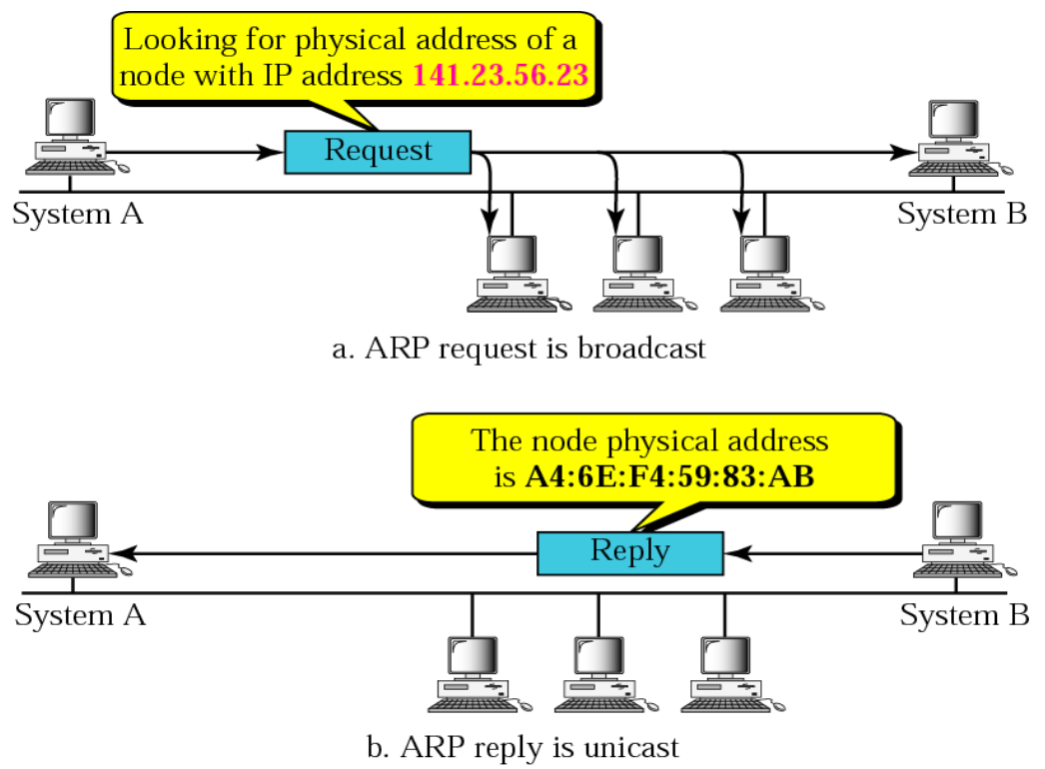
ARP (Address resolution protocol)
ARP Operation

Slide 5
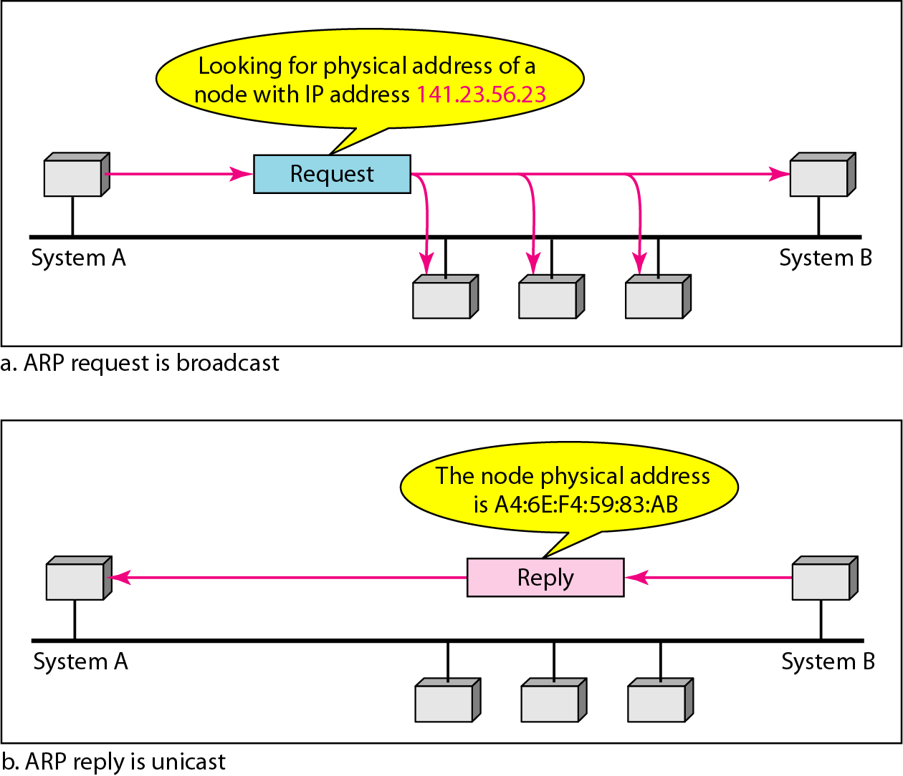
ARP operation
ARP stands for Address Resolution Protocol, which is used to find the MAC address of the device from its known IP address.

Slide 6
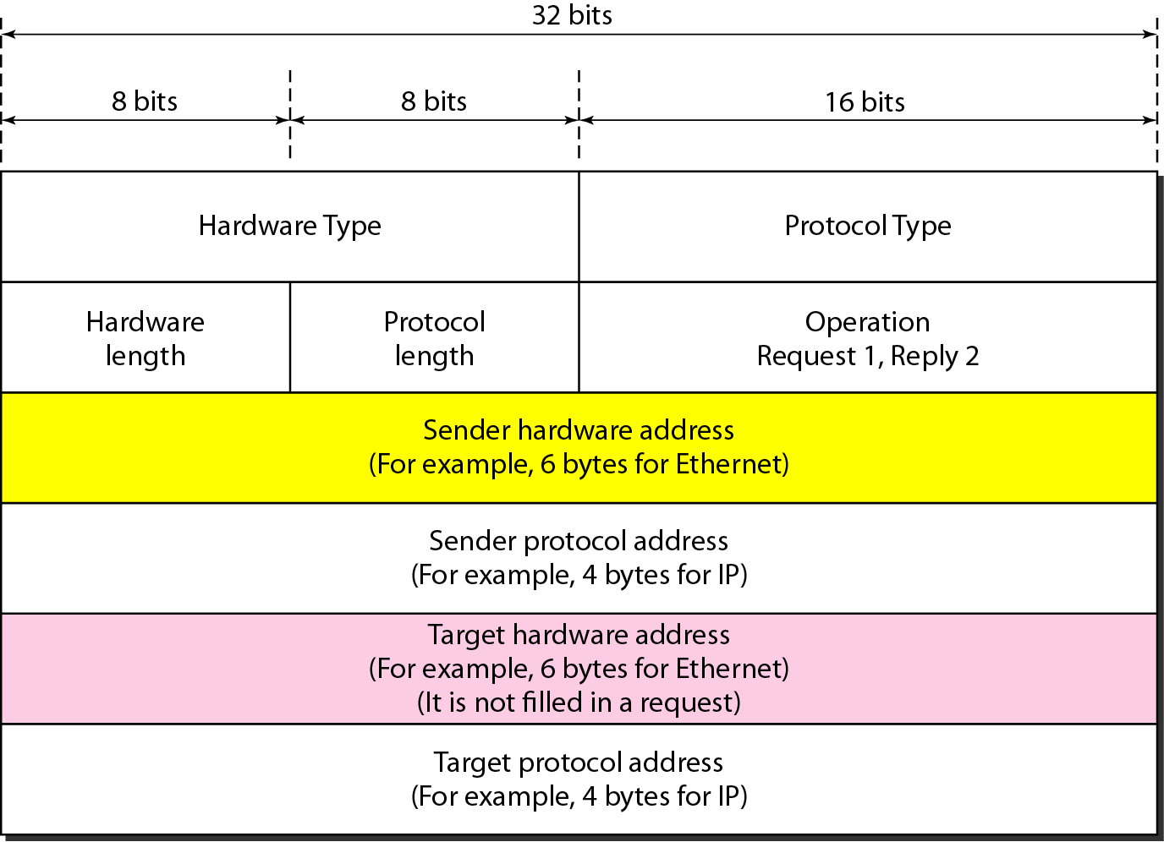
ARP packet format

Slide 7
Fields of ARP packet
Hardware type: It is a 16-bit field that defines the type of network on which address resolution protocol is running.
Protocol type: It is a 16-bit field that defines the type of protocol. Eg. IPV4
Hardware length: It is an 8-bit field that defines the physical address length in bytes.
Protocol length: It is an 8-bit field that defines the logical address length in bytes.
Operations: It is a 16-bit field that defines the types of packets.
There are two types of packets ARP request (1) and ARP reply (2).
Sender hardware address: It is a variable-length field that defines the physical address of the sender.
Sender protocol address: It is a variable-length field that defines the logical address of the sender.
Target hardware address: It is a variable-length field that defines the physical address of the receiver.
Target protocol address: It is a variable-length field that defines the logical address of the receiver.

Slide 8
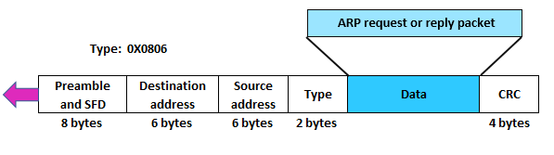
Arp encaptulation

Slide 9
ARP Address Mapping Process
Below is a list of steps involved in the ARP process:
Step 1: The sender knows the IP address of the receiver.
Step 2: The IP asks ARP to create an ARP request message that contains information like sender physical address, receiver physical address field is filled with 0s, the sender IP address and receiver IP address.
Step 3: ARP request message is sent to the data link layer where the message is encapsulated in the frame using the sender’s physical address as a source address and broadcast address as a destination address.
Step 4: Each and every host receives the frame because the frame contains a broadcast destination address. All hosts check the address with their address. If the match founds, the packet is dropped to that host; otherwise, it passes to the address resolution protocol.
Step 5: After receiving the packet, target host will reply with an ARP reply message that contains the target physical address. The message in this step is unicast.
Step 6: When the sender receives a reply message from the target, it knows the target’s physical address.
Step 7: Now, the IP Datagram carries data for the target machine encapsulated and sent in the unicast form to the destination.

Slide 10
DHCP

Slide 11
Dynamic Host Configuration Protocol (DHCP)
The Dynamic Host Configuration Protocol (DHCP) is a network management protocol used on Internet Protocol (IP) networks.
DHCP server dynamically assigns an IP address and other network configuration parameters to each device on the network, so they can communicate with other IP networks.
A DHCP server enables computers to request IP addresses and networking parameters automatically from the Internet service provider (ISP).
This reduces the need for a network administrator or a user to manually assign IP addresses to all network devices.
In the absence of a DHCP server, a computer or other device on the network needs to be manually assigned an IP address.

Slide 12
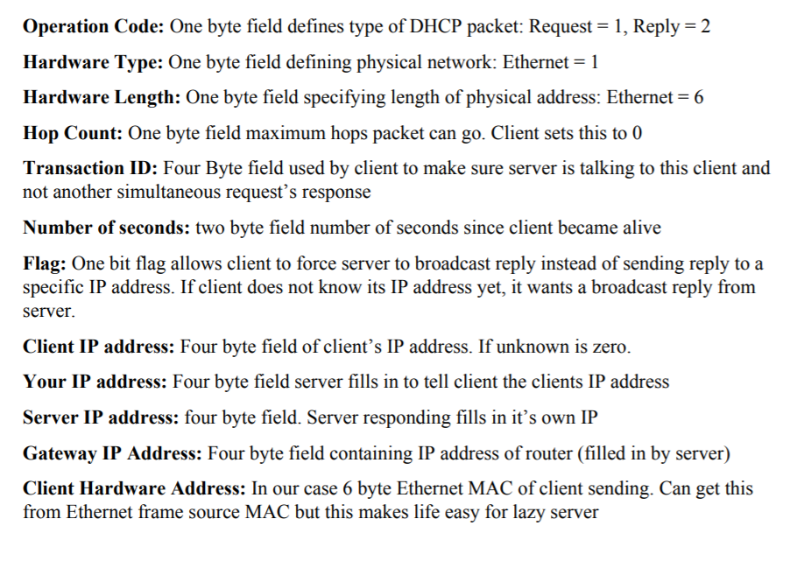
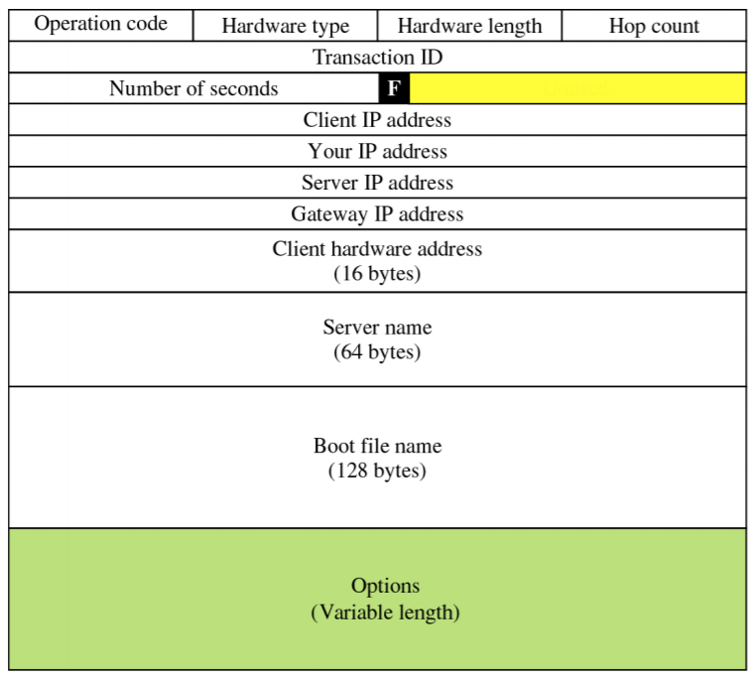
DHCP Message Format

Slide 13
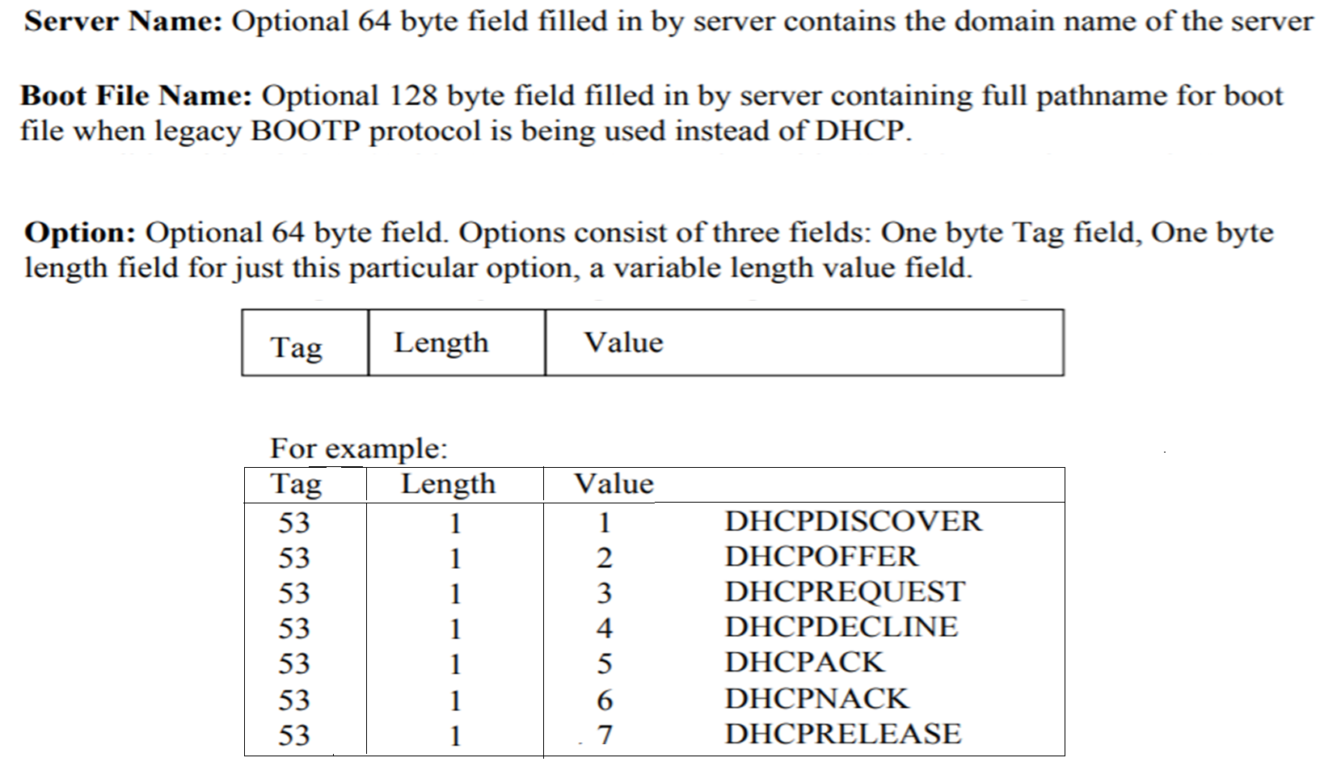
DHCP Message Format…

Slide 14
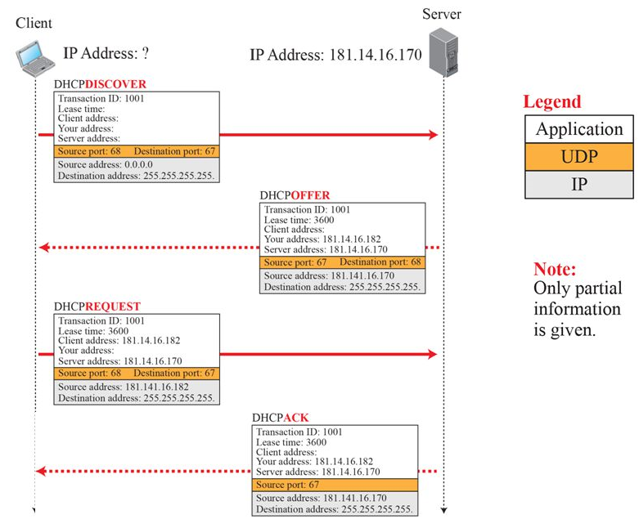
DHCP Operation

Slide 15
DHCP Messages
DHCPDISCOVER
The first time a DHCP client computer attempts to log on to the network, it requests IP address information from a DHCP server by broadcasting a DHCP Discover packet.
It is a broadcast message where the source IP address in the packet is 0.0.0.0 because the client does not yet have an IP address and the destination address is 255.255.255.255.
DHCPOFFER
Each DHCP server that receives the client DHCP Discover packet responds with a DHCP Offer packet containing an unleased IP address and additional network configuration information, such as the subnet mask and default gateway.
More than one DHCP server can respond with a DHCP Offer packet. The client will accept the first DHCP Offer packet it receives.
DHCPREQUEST
When a DHCP client receives a DHCP Offer packet, it responds by sending a DHCP Request packet that contains the offered IP address, and shows acceptance of the offered IP address

Slide 16
DHCP Messages…
DHCP Acknowledge (DHCPAck)
The DHCPACK message is an acknowledgement by the DHCP server that authorizes the DHCP client to start using the network configuration it received from the DHCP server earlier.
DHCPNAK
This message is the exact opposite to DHCPACK described above. This message is sent by the DHCP server when it is not able to satisfy the DHCPREQUEST message from the client.
DHCPDECLINE
This message is sent from the DHCP client to the server in case the client finds that the IP address assigned by DHCP server is already in use.
DHCPRELEASE
A DHCP client sends a DHCP Release packet to the server to release the IP address and cancel any remaining lease.

Slide 17

SUMMARY
ARP Protocol
DHCP Protocol

Slide 18
TERMINAL QUESTIONS
With a neat sketch demonstrate the functioning of ARP and RARP protocols.
With a neat sketch demonstrate the functioning of DHCP protocol.
Discuss in detail the messages communication in DHCP process.

Slide 19
REFERENCES FOR FURTHER LEARNING OF THE SESSION
Reference Books:
Behrouz A. Forouzan , “Data Communication and Networking”, TMH, 5th Edition, 2012.
A.S. Tanenbaum, David J. Wetheral “Computer Networks” Pearson, 5th Edition.

Slide 20
THANK YOU
Team – Network Protocols & Security

